Slide 1

Customer Shopping Behavior Analysis

Slide 2




Project Overview
Exploring customer shopping patterns from 3,900 purchases to inform strategic business decisions.
Spending Habits
Segmentation
Identify key purchasing trends.
Understand customer groups.
Product Preferences
Subscription Trends
Pinpoint popular items.
Analyze recurring purchases.

Slide 3

Dataset Summary
1
2
3
Data Volume
Key Features
Missing Data
3,900 rows, 18 columns of transactional data.
Demographics, purchase details, shopping behavior.
37 values in Review Rating column.

Slide 4
Exploratory Data Analysis (Python)
Data preparation and cleaning using Pandas.
01
02
03
Data Loading & Exploration
Missing Data Handling
Column Standardization
Imported dataset, checked structure and summary statistics.
Imputed Review Rating with median by category.
Renamed columns to snake_case.
04
05
Feature Engineering
Database Integration
Created age_group and purchase_frequency_days.
Loaded cleaned data into MySQL.

Slide 5

Data Analysis (SQL)
Structured analysis in MySQL for business insights.
Revenue by Gender
High-Spending Discount Users
Male: $157,890
Female: $75,191
Identified customers spending above average with discounts.
Top 5 Products by Rating
Gloves, Sandals, Boots, Hat, Skirt.

Slide 6

SQL Insights: Shipping & Subscriptions
Shipping Type Comparison
Express: $60.48 avg. purchase
Standard: $58.46 avg. purchase
Subscribers vs. Non-Subscribers
Subscribers: 1,053 customers, $62,645 revenue.
Non-Subscribers: 2,847 customers, $170,436 revenue.

Slide 7

SQL Insights: Products & Segments
Discount-Dependent Products
Hat (50%), Sneakers (49.66%), Coat (49.07%), Sweater (48.17%), Pants (47.37%).
Customer Segmentation
Loyal: 3,116
Returning: 701
New: 83

Slide 8

SQL Insights: Top Products & Age
Top 3 Products per Category
Revenue by Age Group
Young Adult: $62,143
Accessories: Jewelry, Sunglasses, Belt
Middle-Aged: $59,197
Adult: $55,978
Clothing: Blouse, Pants, Shirt
Senior: $55,763
Footwear: Sandals, Shoes, Sneakers
Outerwear: Jacket, Coat

Slide 9
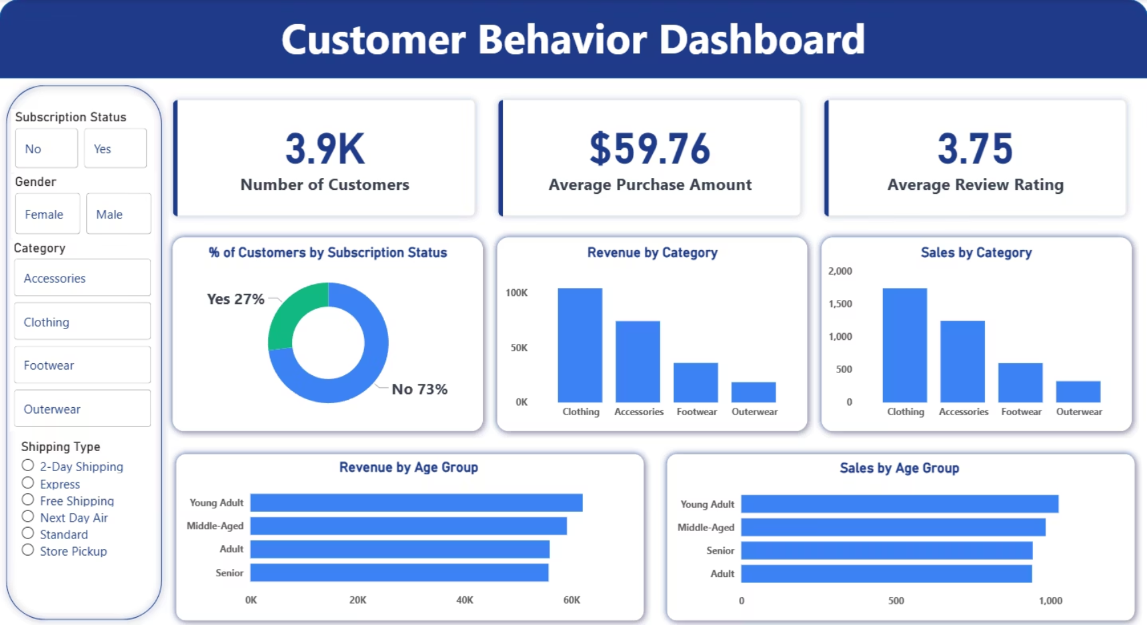
Power BI Dashboard
Interactive visualizations for key insights.

Slide 10





Business Recommendations
Increase Subscription Adoption
Offer exclusive benefits.
Focus on High-Performing Categories
Prioritize Clothing & Accessories.
Optimize Marketing by Age Group
Target Young Adult & Middle-Aged segments.
Customer Loyalty Programs
Reward repeat buyers.
Review Discount Policy
Balance sales with margin control.

